Slide 1
Introduction to Digital Marketing
Module 1

Slide 2
What is Digital Marketing?

Slide 3
What is Digital Marketing
Achieving marketing objectives through applying digital technologies and media.
These digital technologies include the desktop, mobile, tablet and other digital platforms
Over 3 billion people around the globe regularly use digital media and associated technology. Successful digital marketers need to grasp the scope of the changes driven by this technology and how it is changing behaviour.

Slide 4
The Importance of Digital Marketing
Increasing of online customers
Cost-effective and faster
To compete with competitors
Reach customers
New market potential
Establish brand reputation
High revenue

Slide 5
Overview in Digitalization World
Year Founded | Company/Service | Category of Innovation
1994 | Amazon | Retailer
1995 | Yahoo | Directory and portal
1995 | eBay | Online Auction
1996 | Hotmail | Web-based email
1998 | Google | Search Engine
1999 | Blogger | Blog Publishing Platform
1999 | Alibaba | B2B marketplace
1999 | MySpace | Social Network
2001 | Wikipedia | Open Encyclopedia
2003 | Skype | Peer-to-peer Internet telephony

Slide 6
Overview in Digitalization World
Year Founded | Company/Service | Category of Innovation
2003 | Linkedln | Professional social network
2004 | Facebook | Social network
2005 | Youtube | Video sharing and rating
2006 | Paypal | Mobile payment service
2007 | Iphone IOS and Android | iOS and android operating system
2007 | Netflix | Online streaming
2009 | Airbnb | Property owner rent out their houses to consumers for a short stay.
2010 | Uber | Transportation and logistics
2016 | TikTok | Short video-sharing

Slide 46
Trends in Digital Marketing in 2021
Personalization
Social messaging apps
Social media stories
Influencer marketing
Video marketing
Page speed
Text content length not effective

Slide 49
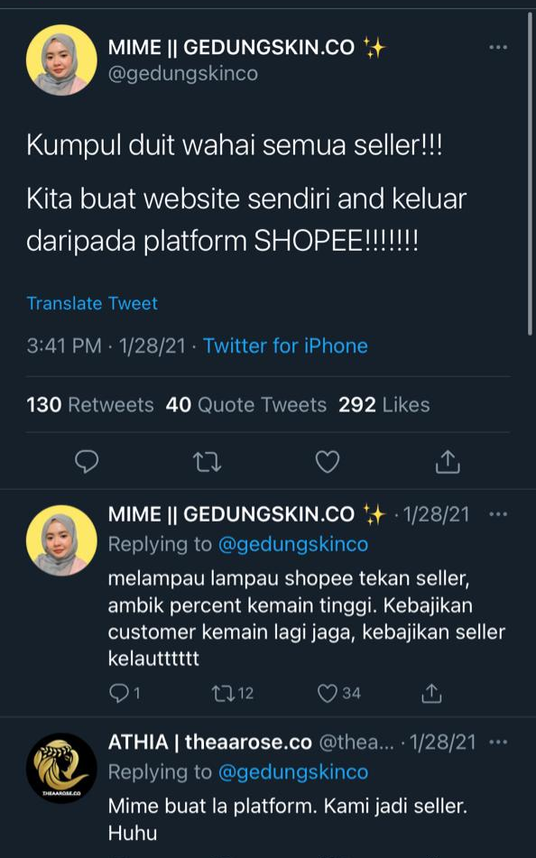
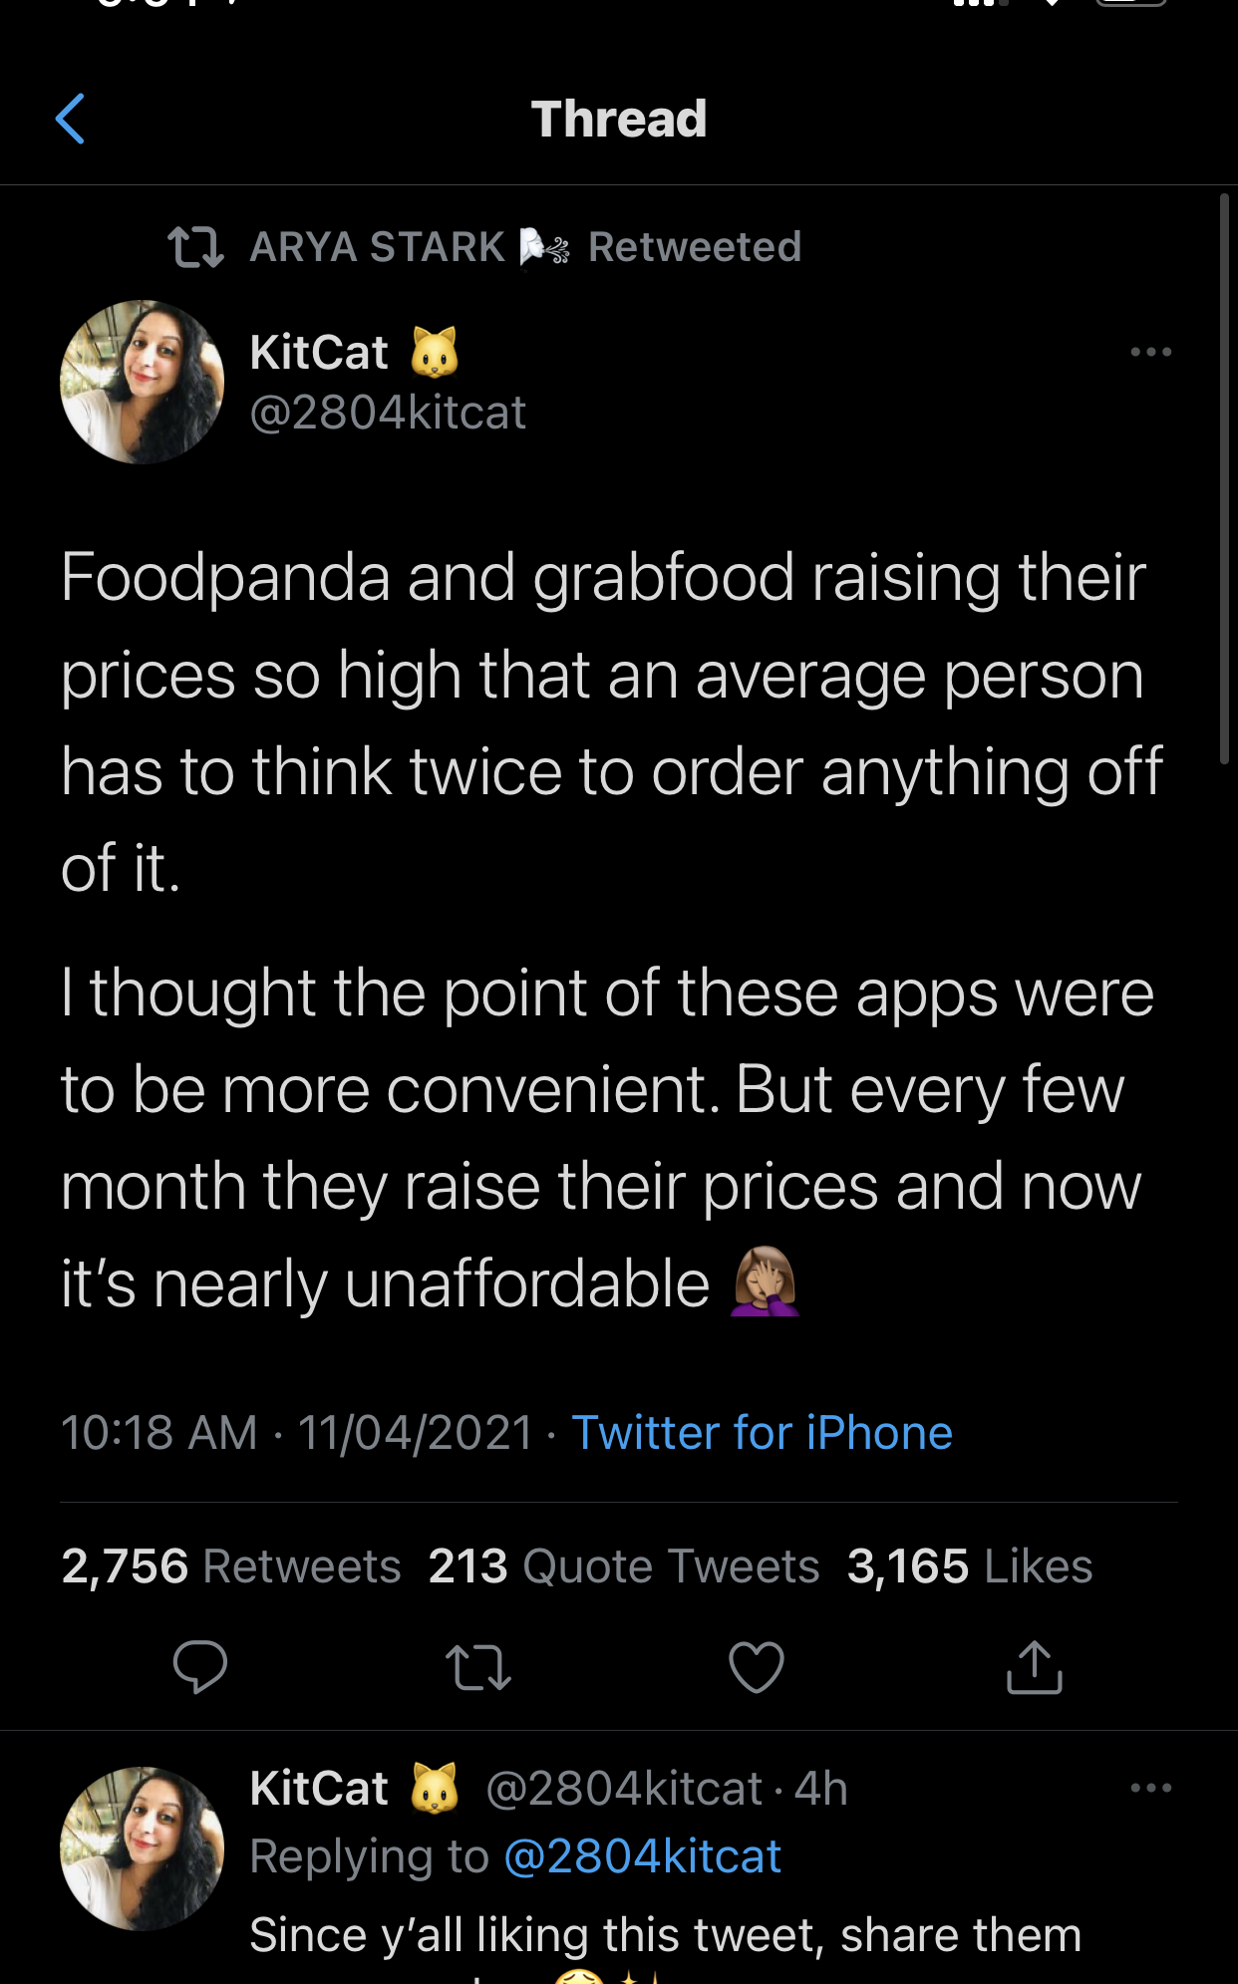

Slide 50
TikToK

Slide 51
We-chat

