Slide 1
DIGITAL MARKETING
MODULE 3

Slide 2
Digital Media Channels in Marketing Communication
Websites
Email
Organic Search (SEO)
Paid Search (SEM)
Display Ads
Mobile
Social Media

Slide 3
Websites (Content Marketing)
Website is an important tool for the business as it provides a dedicated platform where you can educate target audiences about the brand, products, and services.
An ideal channel for the content marketing campaigns.
How it works
Increased organic traffic
Lead generation
Strategies
Create content assets in various formats
Promote your content via social media and email marketing.

Slide 4
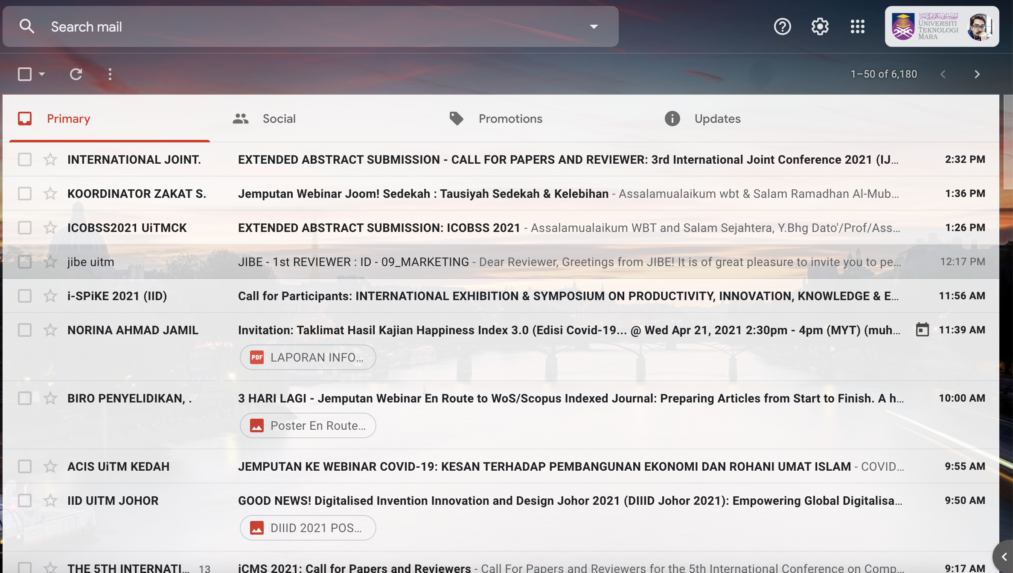
Email
Allows you to apply the latest trends in content marketing, such as personalization and automation.
Email has become so widespread that it reached 3.9 billion users in 2020, and the figure is expected to grow to 4.3 billion users in the subsequent year
How it works
Brand awareness and Conversion
Maintain relationship
Strategies
Craft time-sensitive subject headlines
Personalize your email marketing campaigns
Reserve email for customer feedback and support.

Slide 5
Organic Search (SEO)
People use search engines for research, shopping, and entertainment
How it works
Search rankings.
Strategies
Implement local SEO to market the business within the community and nearby areas.

Slide 6
Paid Search (SEM)
You’re paying for each click you get, unlike SEO, where people find you organically (and technically for free).
The advantage of using paid search is that your ads are shown above organic search results, making them more visible to users.
How it works
Brand awareness
Lead generation and conversions
Strategy
Direct users who click on your ads to the right places on your website, such as landing pages that contain a contact form.

Slide 7
Display Ads
Display ads allow to use images, audio, and video to communicate your advertising message better.
One of the great things about display ads is their ability to track users for retargeting.
How it works
Brand awareness
Sales and conversion
Strategy
Highlight your unique selling proposition (USP)

Slide 8
Mobile
The number of mobile phone users is increasing by the day, and this trend is expected to continue in the years to come.
Smartphone users are also spending 90% of their mobile time using apps and games, which makes mobile apps a profitable marketing channel.
How it works
Increase in sales
Creating demand for your product/service while driving brand value.
Strategies
Create your mobile website or app.
Explore mobile technologies

Slide 9
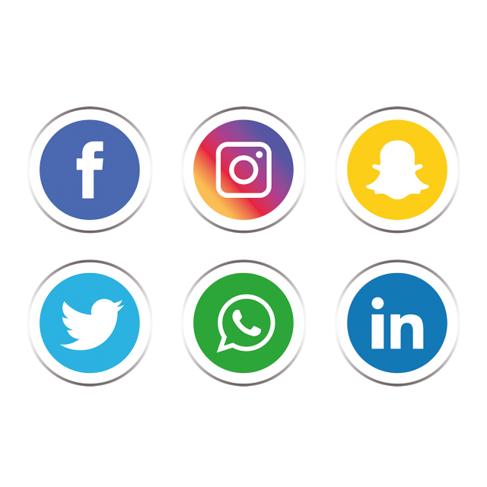
Social Media
Social media users reaching the 3.81 billion mark
Social media can reach out to potential customers by engaging them in a more personal and authentic fashion.
How it works
Customer engagement
Wider audience range
Strategies
Be original
Consistent

Slide 10
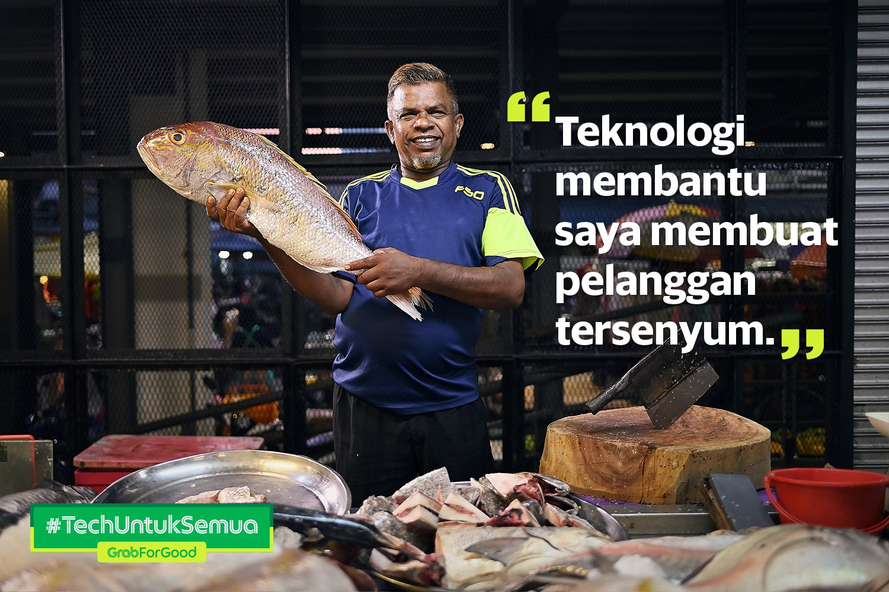
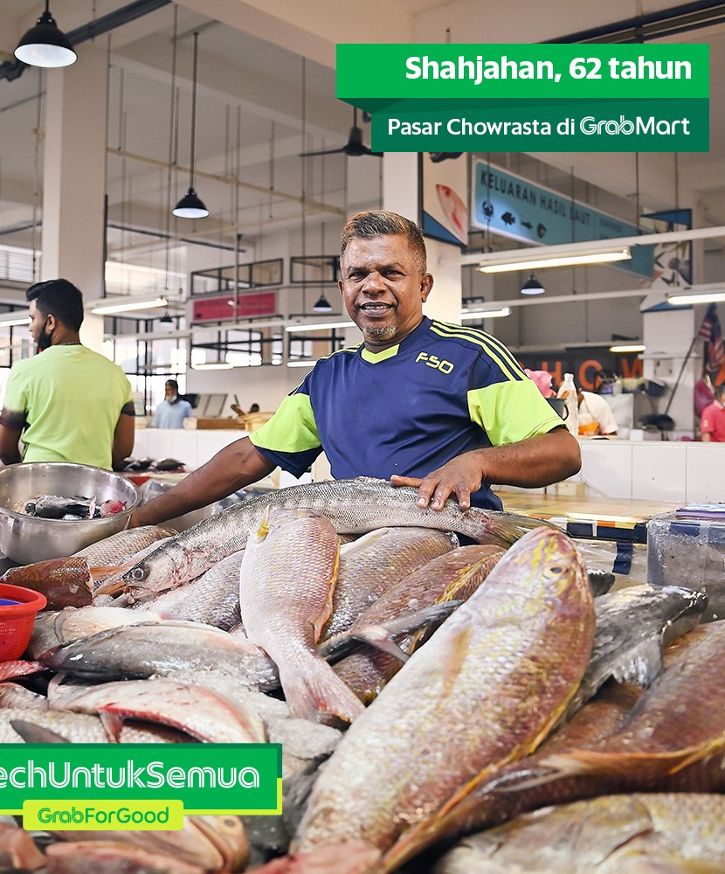

Slide 11
